Slide 1
Middle Street Primary School
Public Consultation
26 January – 9 March 2026

Slide 2
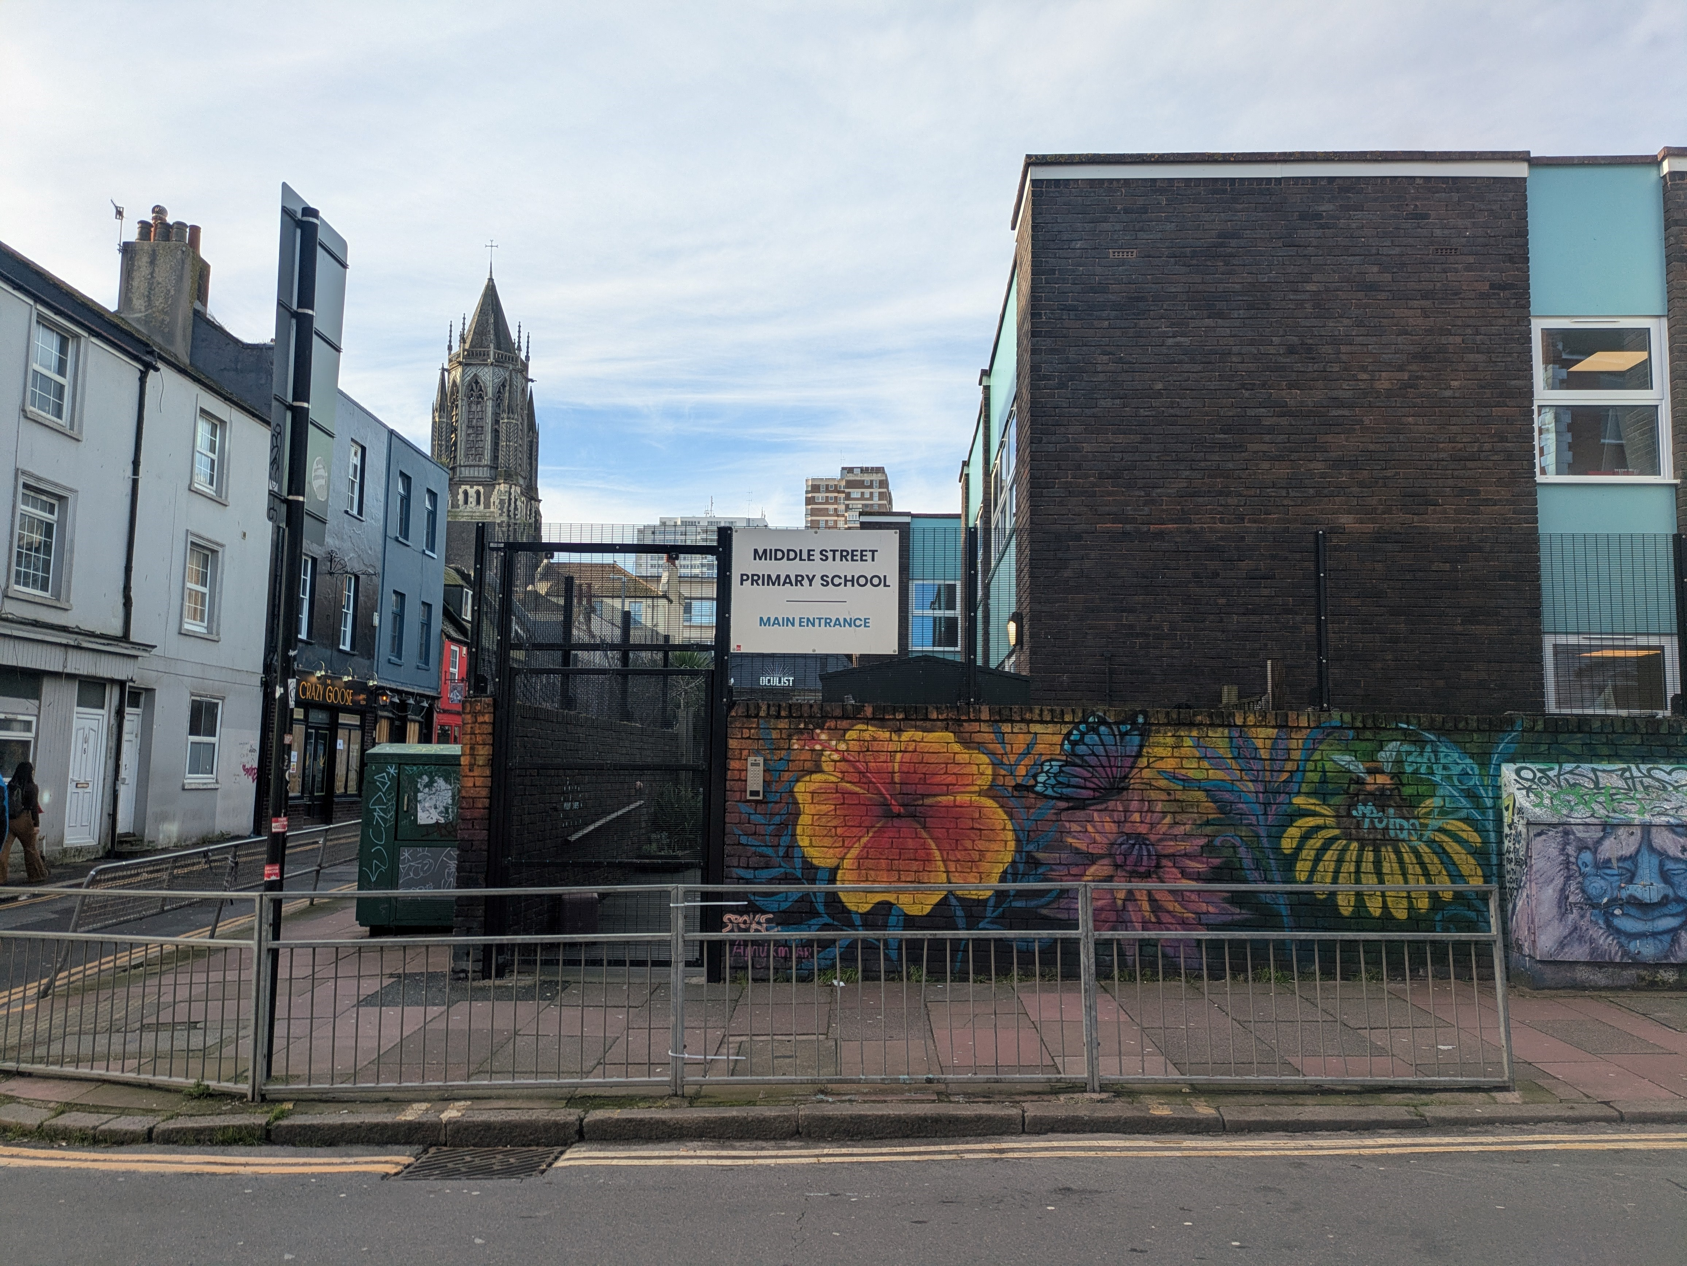
About This Consultation
What’s Being Proposed
In June 2025, an Interim Executive Board (IEB) was appointed to manage challenging financial and governance issues at Middle Street Primary School. Following a recommendation from the IEB, Brighton & Hove City Council is consulting on the proposed closure of the school from 31 August 2026.
This decision has not been reached lightly. The IEB and Interim Leadership Team have invested considerable energy and attention into exploring every possible option for a viable future for the school, but a number of risk factors have emerged that severely limit the school's ability to recover in the foreseeable future.
Why This Consultation Matters
We want to hear from parents, carers, pupils, staff, and the wider community. Your views will help inform the Council’s decision-making process. This is your opportunity to share your thoughts, concerns, and questions.
All responses will be carefully considered before any final decision is made.

Slide 3


Understanding the Challenges
C
Capacity: 210 pupils Current: Under 135 pupils Projected: Further decline
2025/2026 Forecast Deficit: £425,034
Declining
Enrolment
Budget Deficit
Schools are funded by the government on a formula basis. The number of pupils attending a school drives the level of funding received. This means that schools with unfilled places are under increased financial pressure and, over time, are less able to function efficiently.
The school is currently unable to forecast reaching a balanced budget position in the longer term. This unsustainable financial situation severely limits the school’s ability to continue operating effectively.

Slide 4

What Happens Next?
26 January – 9 March 2026
Public Consultation period
19 March 2026
Cabinet considers responses and decides whether to proceed to Statutory Notice
8 April – 5 May 2026
Statutory Notice period (if notice is published) and a further period of 4 weeks for representations
21 May 2026
Full Council will make the decision on whether the school will close on
31 August 2026

Slide 5
Support for Pupils, Families and Staff
Transition Support Available
534 available spaces in schools within a 1.5 miles of Middle Street Primary School.
    Reception - 75 spaces
    Year 1 - 72 spaces
    Year 2 - 106 spaces
    Year 3 - 95 spaces
    Year 4 - 109 spaces
    Year 5 - 77 spaces
A transition programme will be established including educational psychologists and admissions staff to assist families in selecting schools and supporting pupils through transitions.
The current Leadership Team
The Interim Senior Leadership Team will continue to provide support through the remainder of the academic year.
.

Slide 6
How to Have Your Say
Three Public Consultation Meetings
Monday 10 February 1.45pm – 3.15pm
In-person event at Middle Street Primary School
Wednesday 25 February 9.00am – 10.30am
In-person event at Middle Street Primary School
Wednesday 4 March 6pm
Online event via Microsoft Teams
Submit Your Views Online
Visit the Council’s YourVoice consultation portal
Public Consultation on proposed closure of Middle Street Primary School
Consultation closes: 9 March 2026

Slide 7
How to Have Your Say
Your Voice Portal Questions
1. Do you agree with the proposal to close Middle Street Primary School?
2. Do you have any comments or reasons for your answer?
Submit Your Views Online
Visit the Council’s YourVoice consultation portal
Public Consultation on proposed closure of Middle Street Primary School
Consultation closes: 9 March 2026

Slide 8
Time for Questions
26 January – 9 March 2026

